Slide 1



ST83_Team 1
BUG LIFE CYCLE

Slide 2


What is a Bug in software testing?
Expected Result ≠ Actual Result

Slide 3

What are failures called in software testing?
Defect
Bug
Error
Failure

Slide 4
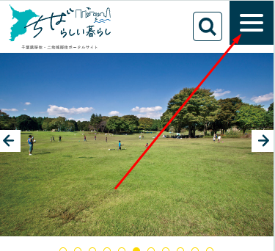
Defect

Slide 5
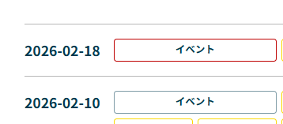
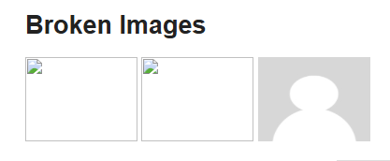
Bug

Slide 6
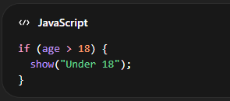
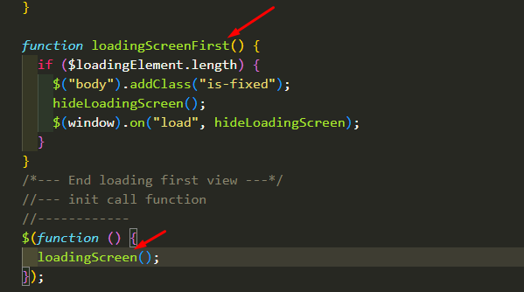
Error

Slide 7
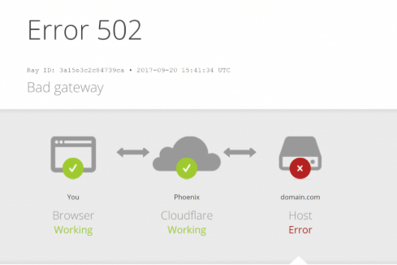
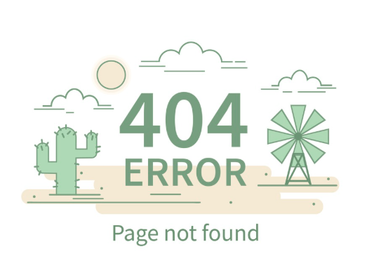
Failure

Slide 8
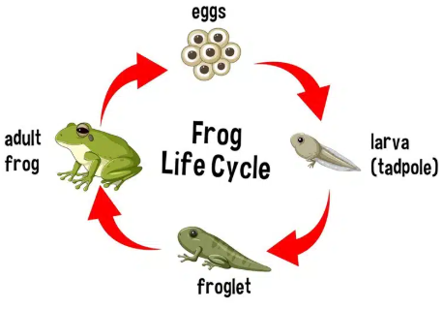
What is life cycle?

Slide 9
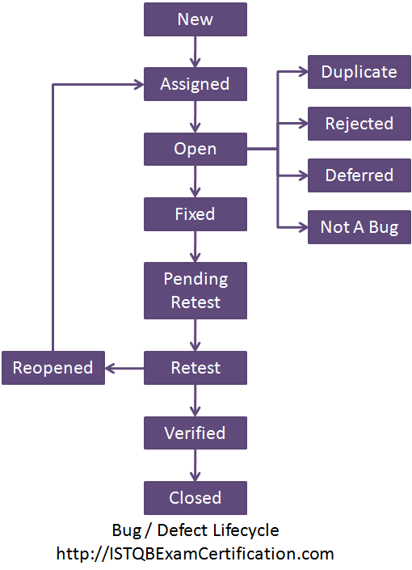
Bug life cycle
What is a bug life cycle?

Slide 10
Importance of Bug Detection
Ensures software quality
Improves user experience (UX)
Reduces system risks and failure
Saves development and maintenance costs

Slide 11
Any questions?

Slide 12

Thank you!

